Slide 1
Critical Minerals & REE In CCR
Danny L. Gray, P. E. ---- Green Cement, Inc.
March 8, 2022

Slide 2
CCRs – Abundant CM & REE Resource
Coal Combustion Residuals – Fly Ash, Bottom Ash & Flue Gas Products
Typical Handling Methods – Slurry Impoundments & Landfills
Typical Utilizations – Construction Products – Broad Distribution
Critical Minerals – REE – Typical Conc – 300-800 PPM
Large Volume Production Over Decades of Coal Fired Generation
ACAA Published Annual Production & Use Data – Utilization/Storage
Estimated 1.5 – 3 Billion Tons In Storage Facilities
Small Sites – 1 Million Tons Large Sites 20+Million Tons In Storage

Slide 3
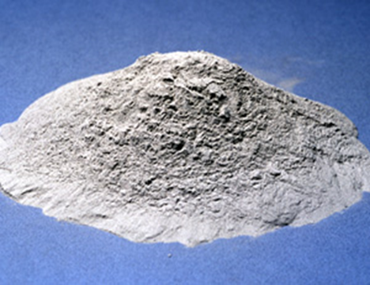
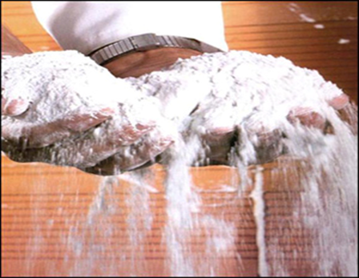
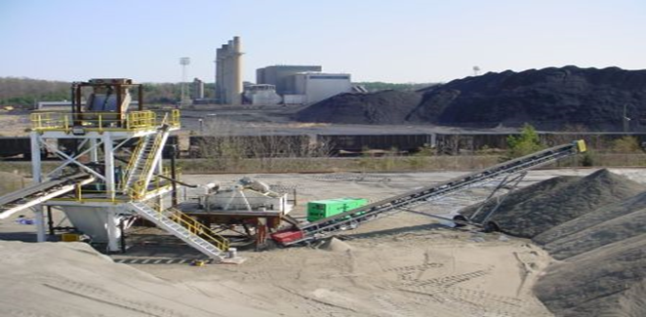
CCRs – Abundant CM & REE Resource
Coal Combustion Residuals – Fly Ash, Bottom Ash, Slag & Flue Gas Products
Estimated 1.5 – 3 Billion Tons In Storage Facilities
Typical Storage – Slurry Impoundments & Landfills
Small Sites – <1 Million Tons; Large Sites 20+Million Tons In Storage
Critical Minerals – REE – Typical Conc – 300-800 PPM
Target Source – Enriched Fly Ash Due To Minerals Processing – Small Particle

Slide 4
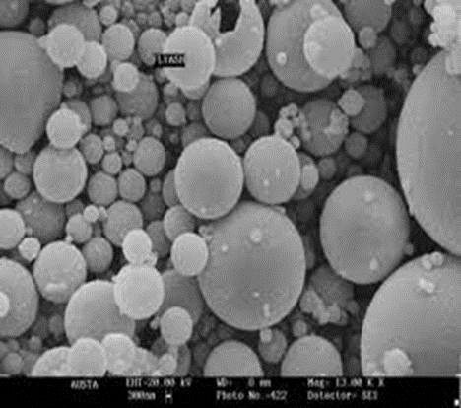
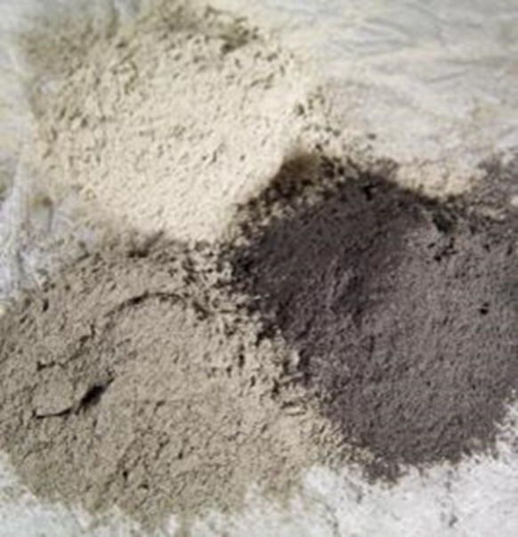
REE & CM In Fly Ash
REE & CM – Higher Concentrations In <200 Fly Ash ( 75 Micron)
Carbon & Sulfur-Flue Gas Products Complicate Processing/Recovery
Central App – Higher REE
Average REE In <200 Mesh – 500 PPM
Simple Assumption -Must Handle 2,000 Ton Per 1 Ton Of Total REE – If All Ore<200 & Perfect Extraction Process

Slide 5
Large Material Handling Challenge
Broad Distribution – Resources Scattered Over 800+ Facilities
Regulatory Requirements – Impediment For Harvesting
Solid Waste Permit Sites
Wastewater Permits
Air Permits
RCRA Liabilities Assumption
Dewatering Programs & Drying Required
Centralized Processing w/ Multiple Feedstocks
Concentration Of Plants In Ohio River Valley
Water Transport Improves Logistics Cost
Goal To Create Market For Residues From REE/CM Processing
Current CCP Production Trends – Production - Utilization

Slide 6
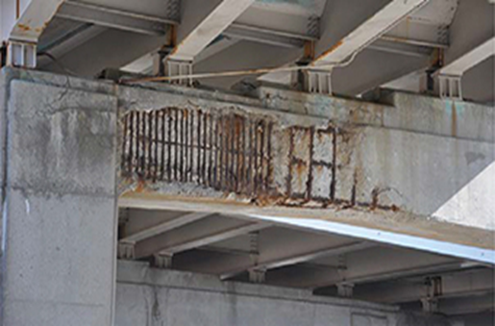
Markets - Mature
Ready Mixed Concrete
Wallboard
Roofing Shingles
Carpet Backing
Lightweight Plastics
Lightweight Aggregates
Agriculture Sulfur Source
Oil & Gas Drilling

Slide 7
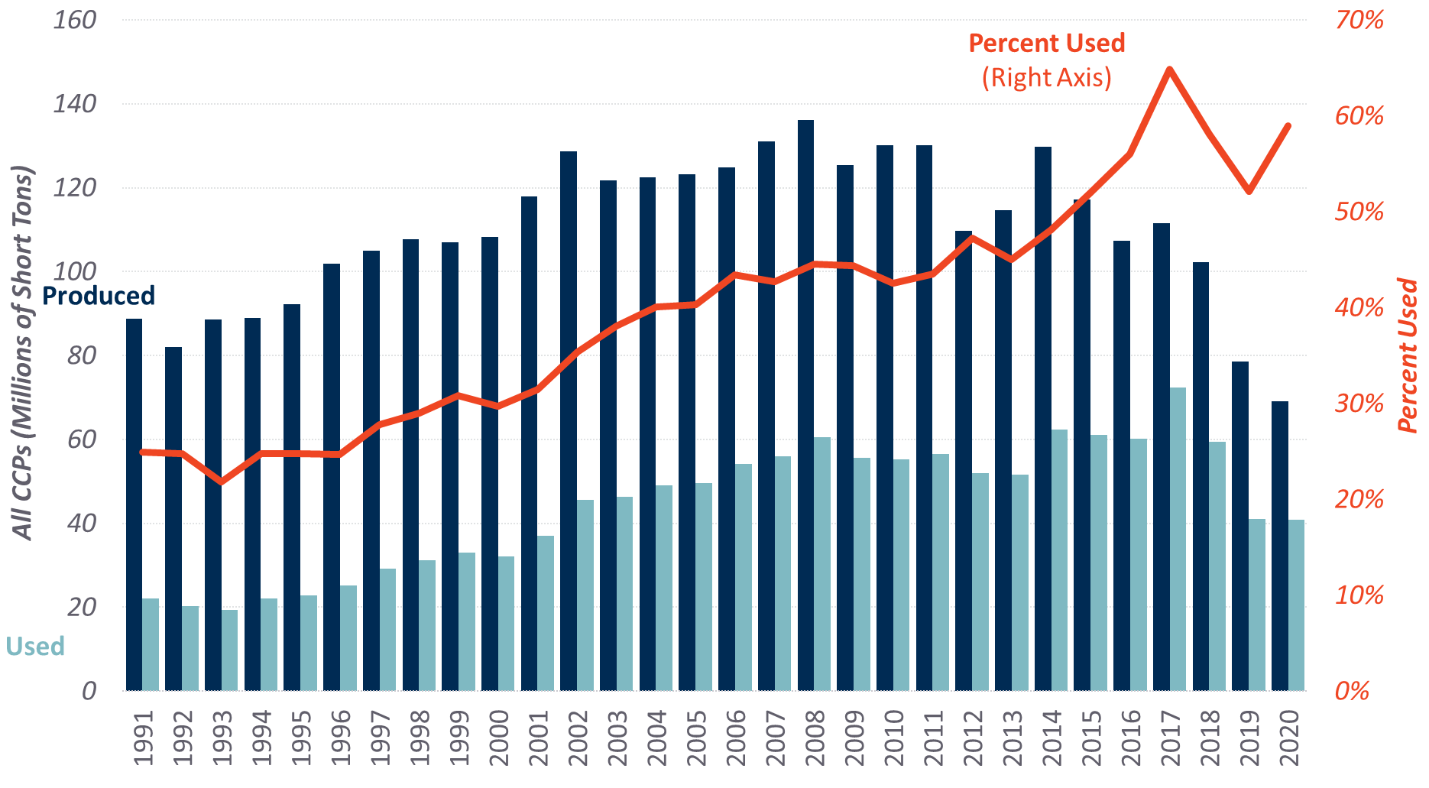
All CCP Production & Use (1991–2020)

Slide 8
ACAA Survey Data -

Slide 9
REE/CM Resources Via CCR Utilization
Large Volume Ore Source
Utilization Brings Environmental Benefits If Coupled With Extraction Processing With Usable Co-Products
Mineral Particle Sizing Completed By Coal Plant Process
Trends In Construction Market Driving Needs To Harvest
Trends In REE/CM Market Driving Demand Growth
Logistics Costs Drive Decisions On Plants

