Slide 1
Southern States Energy Board
Winter Virtualization Session
TRANSCOM Remote Training Opportunities
December 2nd, 2020

Slide 2
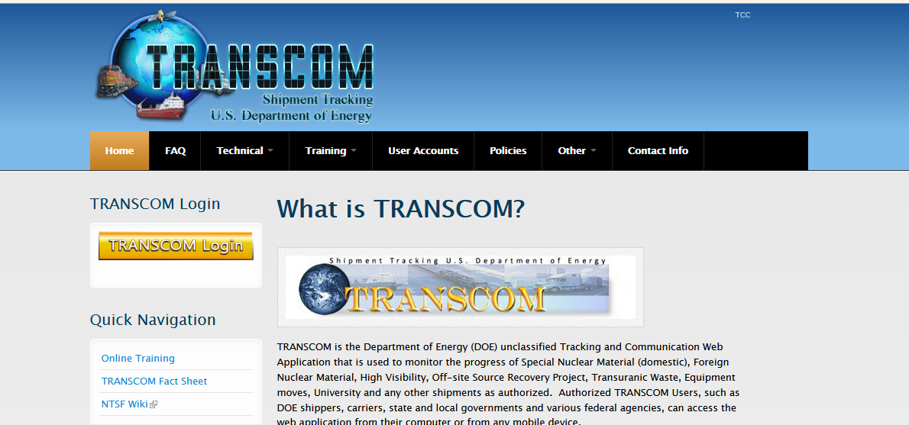
Southern States Energy Board
Winter Virtualization Session
TRANSCOM Remote Training Opportunities
TRAINING REQUIREMENTS for ALL USERS: CYBER SECURITY and GENERAL USER
On-Line CBT is available at: https://tcc.transcom.energy.gov

Slide 3
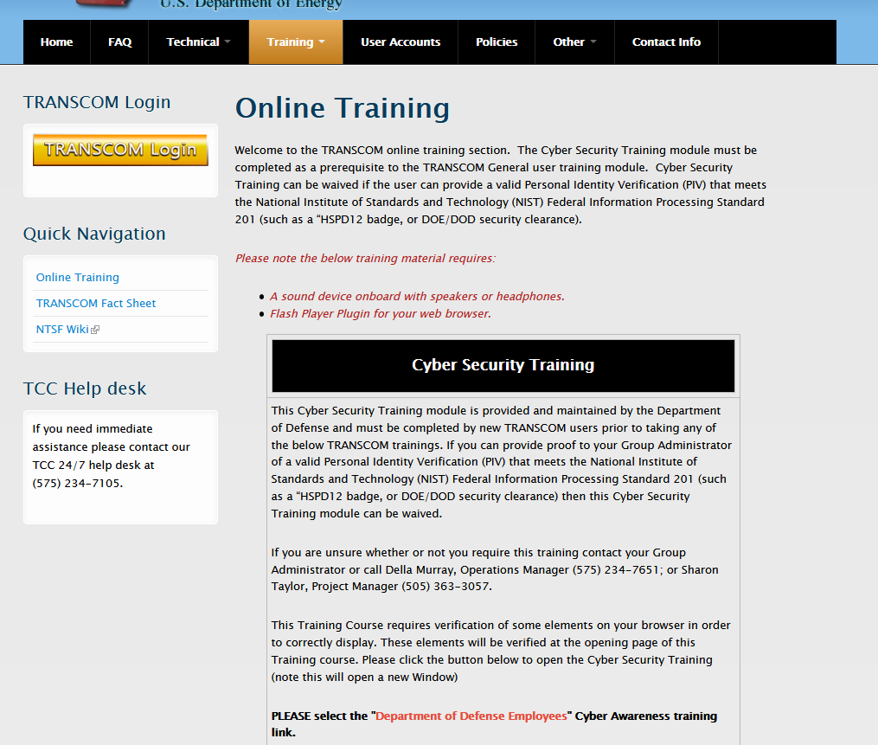
Southern States Energy Board
Winter Virtual Session
TRANSCOM Remote Training Opportunities
CYBER SECURITY AWARENESS TRAINING
Required for initial TRANSCOM access
Required for annual refresher training
This course is available online from the TCC Support Site
NOT required for TRANSCOM Users with an ACTIVE personal identification verification (PIV) badge (Example: HSPD12, DOD or DOE clearance)
On-Line CBT is available at: https://tcc.transcom.energy.gov

Slide 4
Southern States Energy Board
Winter Virtual Session
TRANSCOM Remote Training Opportunities
GENERAL USER TRAINING
Required for initial TRANSCOM access
Recommended for annual refresher training
This course is available online from the TCC Support Site
On-Line CBT is available at: https://tcc.transcom.energy.gov

Slide 5
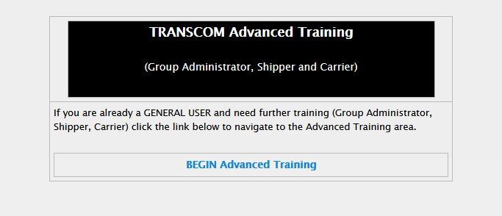
Southern States Energy Board
Winter Virtual Session
TRANSCOM Remote Training Opportunities
ROLE SPECIFIC TRAINING:
Group Administrators
Shippers
Carriers
These courses are also available online on the support site:
https://tcc.transcom.energy.gov

Slide 6
Southern States Energy Board
Winter Virtual Session
TRANSCOM Remote Training Opportunities
EXAMS
Exams with a passing score of 80% are required as proof of training.
Exams are available on the same module as the training “Begin Exam”
Upon selecting Exam, the user will be prompted to enter information:
1. First and Last Name
2. Email (work)
3. User Organization
Upon completion of exam, a report of your results will be sent to the email address you provided. Training results should be forwarded to your Group Administrator.
The TRANSCOM Communication Center also receives email notification of completion of training.
On-Line CBT is available at: https://tcc.transcom.energy.gov

