Slide 1
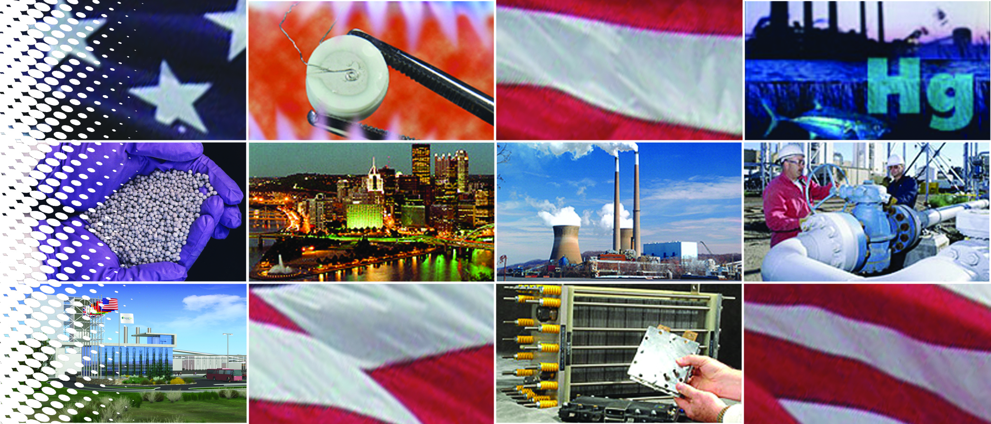
NETL – A Catalyst for Energy Innovation
Anthony Cugini

Slide 2
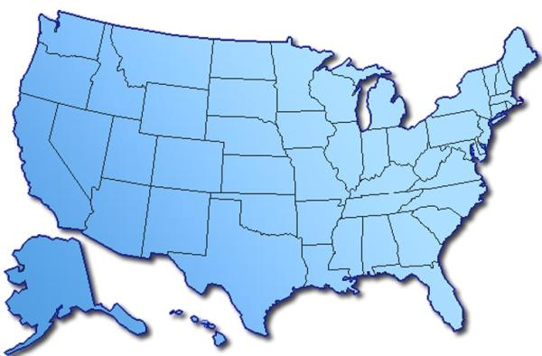
National Energy Technology Laboratory
Full-service DOE Federal laboratory
  Program Planning
  Budget Formulation and Execution
  Procurement
    Contracting and Financial Assistance
  Project Management
    Including NEPA
  Legal
  Financial Management and Reporting
  On-site Research
  Program Performance and Benefit Analysis
Dedicated to energy RD&D, domestic energy resources
  Fossil Energy
  Support OE and EE
Fundamental science through technology demonstration
Unique industry–academia–government collaborations
Albany,
OR
Pittsburgh, PA
Morgantown,
WV

Slide 3
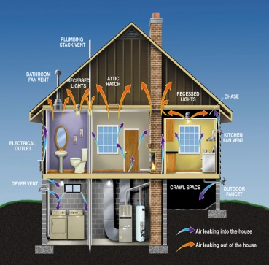
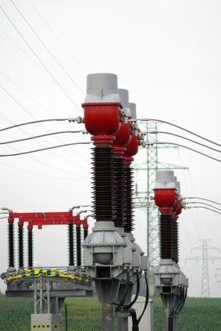

NETL Research Budget Oversight
Fiscal Year 2010
Energy Efficiency
~ $ 1.4 Billion
Electricity Delivery &
Energy Reliability
~ $ 80 Million
Fossil Energy
~ $ 430 Million
NETL Also Manages > $15 Billion ARRA Funding

Slide 4
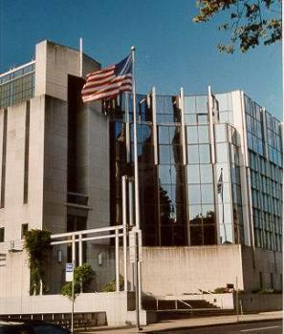


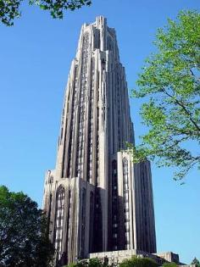

NETL’s Alliance with Regional Universities
Regional University Alliance (RUA)
Carnegie Mellon University
Virginia Polytechnic Institute
Pennsylvania State University
West Virginia University
University of Pittsburgh
Leveraging National Lab and University-Based Scientific and Engineering Assets to Address Significant National Energy Issues

Slide 5
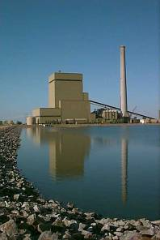
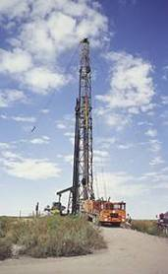

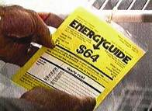
Extramural Research & Collaboration
Developed, Demonstrated, Deployed
Coal
Natural Gas
and Oil
Project Management

Slide 6

Benefits from Clean Coal R&D
A retrospective Look . . .
$100 Billion in Benefits
2500% ROI
Significantly Lower NO_{x}, SO₂ Pollution
Acid Rain Reduced
Air Quality Improved
25 MM Tons Avoided NO_{x} Emissions
2 MM Tons Avoided SO₂ Emissions
Lower-Cost Pollution
Control
Lower Electric Bills
Clean, Efficient FBC
Technology
900% ROI
Fuel Cell R&D
250 KW Fuel Cell
Reduces Air Pollution Equal to 120 Cars
Source : http://www.fe.doe.gov/aboutus/FE_ResearchProgram_Brochure_012309.pdf

Slide 7
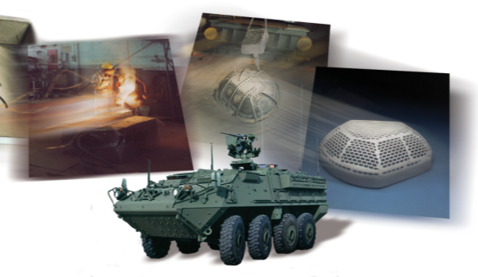
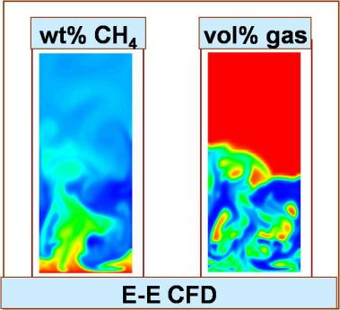
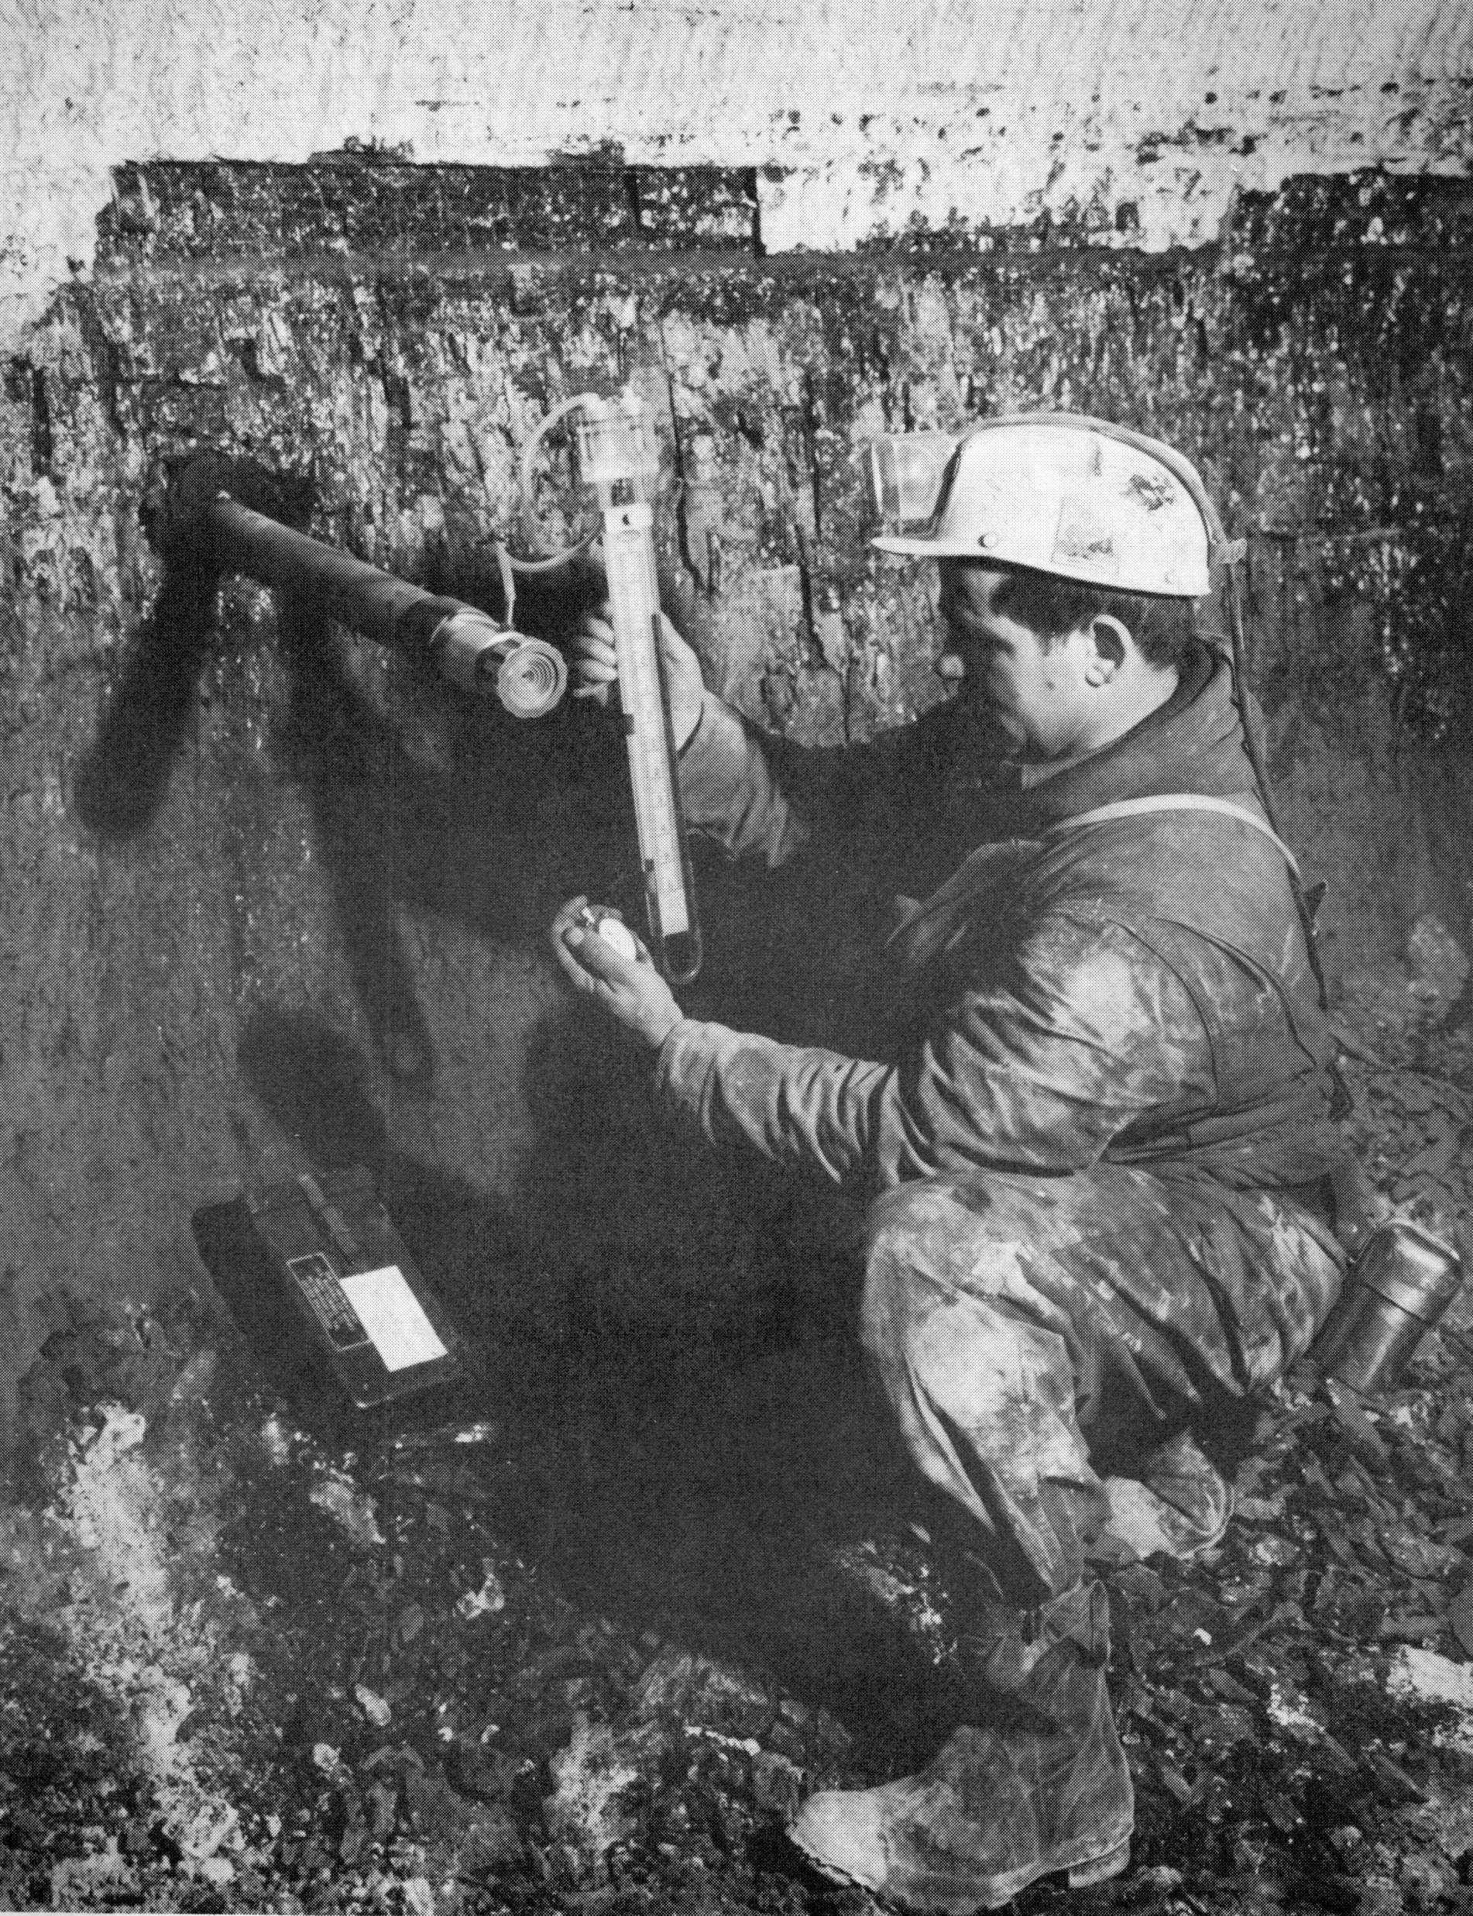
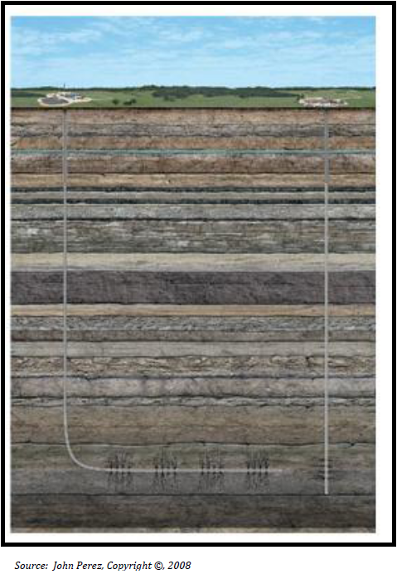
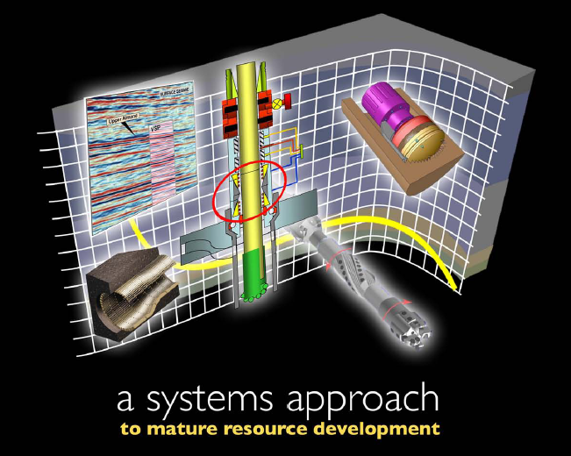
Success Stories
Lost-Foam Casting
Fluidized
Bed
Combustion
Coal-Bed Methane
Microhole and Horizontal Drilling

Slide 8
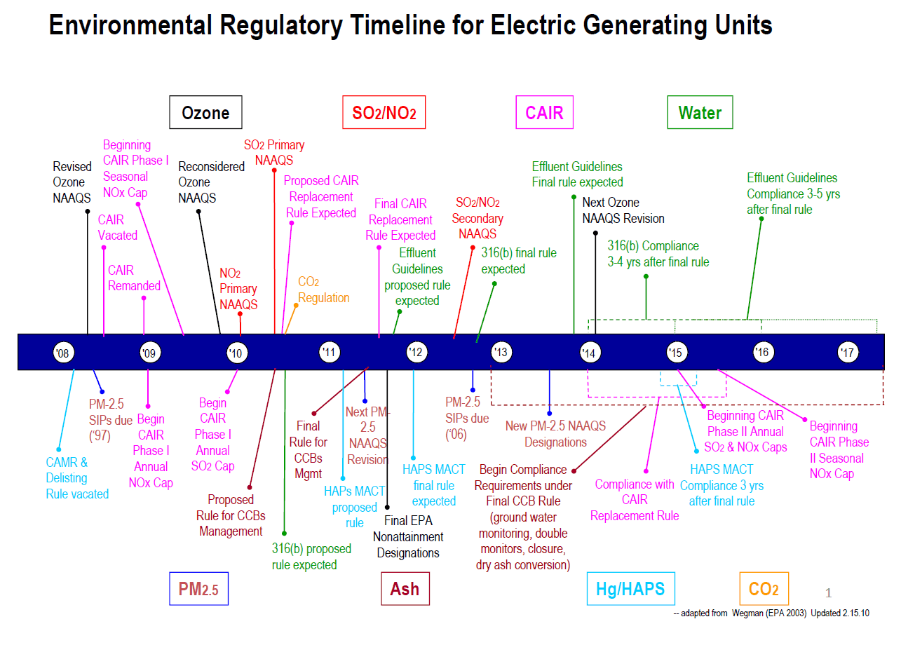
Collective Regulatory Impacts on Coal
Source: Quinlan Shea, Executive Director, Environment, for the Edison Electric Institute (EEI); Presentation to Congressional Caucus on Coal;
May 25, 2010

Slide 9
Projected Lost Coal Capacity by 2020
 | EPA | NERC/EVA | ICF | CERA | NETL
CATR Only | 1 GW | * withheld | n/a | n/a | n/a
Conventional Coal Regs only | n/a | * withheld | n/a | n/a | n/a
Conventional +CO₂ Uncertainty | n/a | n/a | 15-80 GW | 75-159 GW | ≈100 GW
* - Preliminary NERC estimates not yet releasable
Notes:
CATR – EPA’s Clean Air Transport Rule for SOx, NOx and particulates

Slide 10
Impact of Utility-based Climate Legislation and Transport Rule
U.S. Coal Unit Sizes (2010 and 2020)
Most Likely for retrofit
180 Units
271 Units
29 Units
20 Units
92 Units
499 Units
3 Units
369 Units
Existing
Existing
Existing
Potential 100 GW of Retirements and 6 GW of Parasitic Load Loss Due to CCS Retrofits

Slide 11
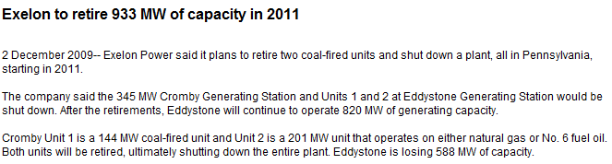
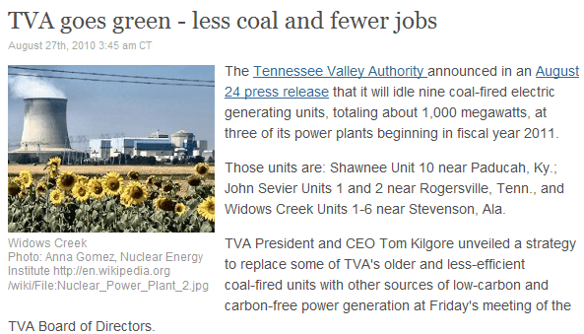
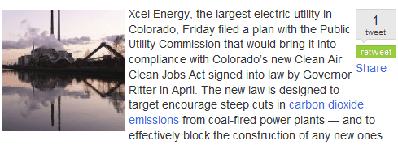
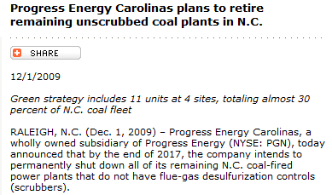
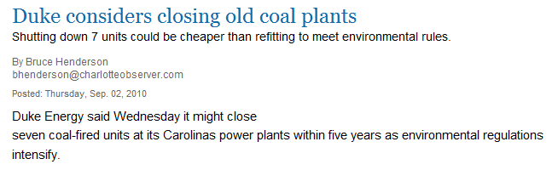
Early Coal Plant Retirement Announcements
Shaw Group…said two-thirds of U.S. coal-fired power plants would need to be equipped with pollution-control equipment or converted to cleaner-burning fuels in the next 10 years, or retired. Wall Street Journal, 23-Apr-10
Notes:
11
Example:
Progress Energy of Raleigh, N.C., intends to shut 11 coal-burning plants in North Carolina by 2017, representing about a third of its capacity there. Spokesman Mike Hughes said it would cost $1.5 billion to swap coal capacity for gas capacity but would have cost more than $2 billion to equip the coal units with pollution-control equipment.
After 2017, Progress will have only three coal-burning power plants in North Carolina—basically just units that were big enough and new enough to justify a $1 billion investment in scrubbers.

Slide 12
Can the U.S. Manage the Displacement of ≈ 100 GW of Coal-fired Generation in Less than 10 years?

Slide 13
Effect on Natural Gas Consumption of Replacing 1/3rd of Coal Generation
Growth Due to
Coal Displacement
Tcf
Industrial
Electric Power
Increase of nearly 5 Tcf in 8 years;
3 Tcf > than EIA’s 20-year projected supply increase

Slide 14
Sources of Incremental Natural Gas Supply (AEO’10 indexed to 2007 actual)
Lower 48 Unconventional
(Shale and CBM)
Alaska
Net LNG Imports
+1.9
Tcf
(vs. 2007)
Tcf
Net Supply Increment
Net Pipeline Imports
Lower 48 Conventional*
* - Includes supplemental supplies, lower 48 offshore, associated-dissolved, and tight gas production
Improvement in Unconventional Production Largely Offset by
Declines in Conventional Production and Net Pipeline Imports
Source: EIA, AEO’10

Slide 15
Average Real Cost of Fossil Fuels for Electricity Generation
Oil
$/mmBtu
($2010)
Natural Gas
?
Average Fossil Fuel
Coal
Would the Impact on Fossil Fuel Prices of a Large Displacement of Coal-fired Power with Natural Gas be Much Higher Prices and Volatility?
Sources: EIA, Electric Power Monthly, Table 4.1; BEA, GDP Deflator

Slide 16


Energy Demand 2007
Energy Demand 2030
102 QBtu / Year
85% Fossil Energy
111 QBtu / Year
79% Fossil Energy
Coal
22%
Gas
24%
Coal
22%
Gas
23%
+ 9%
Nuclear
8%
United States
Nuclear
8%
Oil
39%
Oil
34%
Renewables
7%
Renewables
13%
5,975 mmt CO₂
6,164 mmt CO₂
477 QBtu / Year
81% Fossil Energy
666 QBtu / Year
80% Fossil Energy
Coal
29%
Gas
21%
+ 40%
Nuclear
6%
World
Oil
30%
Renewables
14%
28,826 mmt CO₂
40,225 mmt CO₂
Sources: U.S. data from EIA, Annual Energy Outlook 2010; World data from IEA, World Energy Outlook 2009

Slide 17
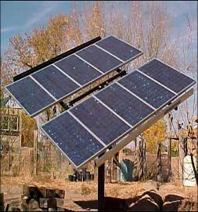

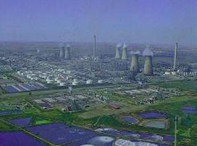
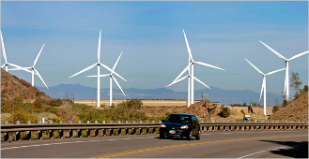
CO₂ Management Options
Increase efficiency of energy use
Increase conservation
Fuel switching to lower carbon intensive fuels
Carbon Capture and Storage
  Enhance natural carbon sinks
  Capture and store CO₂ from fossil fuels
  CO₂ “re-use”
Notes:
All options need to supply energy demand and meet environmental objectives.

Slide 18
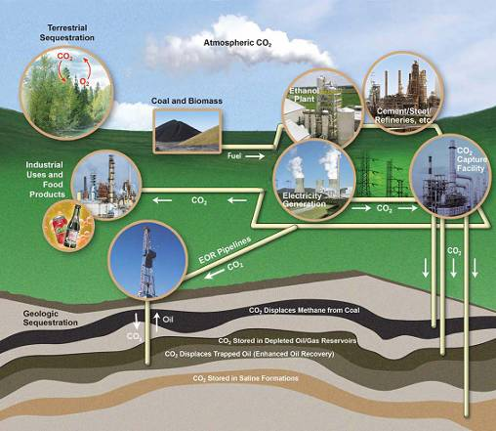
Carbon Capture and Storage
Point Source Capture
Power plants
Ethanol plants
Cement & steel refineries
Natural gas processing
Terrestrial Capture
CO₂ absorbed
from air
Terrestrial Storage
Trees, grasses, soils
Transportation
Pipelines
Geologic Storage
Saline formations
Depleted oil & gas fields
Unmineable coal seams
Basalts and shales
Capture and Storage of CO₂ and Other Greenhouse Gases That Would Otherwise Be Emitted to the Atmosphere
Notes:
18

Slide 19
Pulverized Coal Power
CO₂ Capture Research Areas
Steam
Turbines
Power
Nitrogen
Post-
Combustion
Pulverized Coal
Fuel
Boiler
Air
Flue Gas
CO₂
Capture
CO₂
Amine scrubbing: already in use for gas scrubbing, at smaller scale.
Reversible chemical reaction with CO2 releases CO2 with heat addition.
Base
W / Capture
Net power (MWe) 550 550
Efficiency (HHV) 36.8% 24.9%*
Basis CO₂ compressed to 2200 psi, 50 mile transport

Slide 20

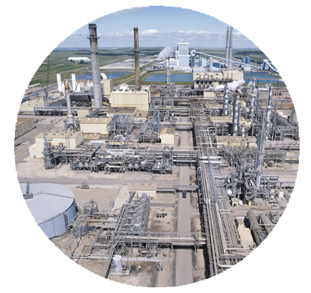
Scale-Up Challenges to
Current Capture Technologies
Cost
Energy
Penalty
Water
Ethanol Refinery
Steel Plant
17,000 TPD
Cement
Plant
4,000 TPD
Coal-fired
Power
Plant

Slide 21
Example CO₂ Capture Developments
Post-combustion (existing, new PC)
Pre-combustion (IGCC)
Oxycombustion (new PC)
CO₂ compression (all)
Chemical looping
OTM boiler
Biological processes
Ionic liquids
Metal organic frameworks
Enzymatic membranes
PBI membranes
Solid sorbents
Membrane systems
ITMs
Biomass co- firing
Advanced physical solvents
Advanced chemical solvents
Ammonia
CO₂ com- pression
Cost Reduction Benefit
Amine solvents
Physical solvents
Cryogenic oxygen
CO₂ Capture Targets:
90% CO₂ Capture
<10% increase in COE (IGCC)
<30% increase in COE (PC)
2010
2015
2020
Time to Commercialization
OTM – O₂ Transport Membrane (PC)
ITM – O₂ Ion Transport Membrane (PC or IGCC)
Notes:
Vary in maturity, benefits if successful and risk. Many at the laboratory/bench scale (< 0.5 Mwe). Goal is to have projects demonstrated in 2013 and 2016 and commercially available by 2020
90% Carbon Capture Performance Target—not intended to set policy, technical/engineering target. Most all approaches can be designed to capture <90% for PC and IGCC
2010:
2012:
Advanced Physical Solvents: New physical solvents for pre-combustion applications—example are synthesis of new glycol/water mixtures
Advanced Chemical Solvents: Next generation amine mixtures such as MHI’s KS-1 and Econamine FG+. New synthesized CO2 oligomers, new ionic liquid/amine mixtures, liquid carbonate systems, new amino acid synthesis.
Ammonia: Alstoms chilled ammonia and Powerspans Aqueous Ammonia.
CO2 compression: Ramgen shockwave compressor (reduces compression capital cost by 50%)
2015:
PBI Membranes: Polybenximidazol membranes (polymer) for high temperature pre-combustion H2/CO2 separation.
Solid Sorbents: Both chemical (amine based) and physical (Selexol or glycol) based solid sorbents for pre and post combustion applications.
Membrane systems: Advanced ‘membrane systems’ designed to minimize membrane surface area, reduce compression/recompression parasitic load and improve CO2/H2 or CO2/N2 separation efficiency.
ITMs: Ion Transport Membarne (Air Products O2 membrane) for IGCC and PC applications
Biomass co-firing: Off-setting a portion of CO2 with renewable co-firing (up to 30%) for IGCC and PC-air fired and oxyfired applications
2018:
Ionic Liquids: Second generation of ionic liquid mixtures and high concentration ionic liquid CO2 capture systems (to manage ionic liquid viscosity)
Metal Organic Frameworks (aka MOFs): High surface area, low CO2 reaction energy solid sorbents with high thermal and chemical stability. Includes the development of low cost dry solid sorbent systems.
2018:
Enzymatic Membranes: Hybrid membrane/liquid systems (chemical or physical) designed to improve the gas/liquid CO2 separation for post-combustion applications. Membrane functions as a high surface area contact device to maintain high CO2 separation driving force.
2020:
Chemical Looping: Advanced coal oxycombustion without the need for a separate cryogenic air separation unit. A metal-based (Cu, Fe, Ca, Ni…) substrate is circulated between an oxidizing and reducing environment thereby transferring the oxygen contained in the combustion air directly to the fuel (coal in this case), generating a pure stream of CO2 and steam to power.
OTM Boiler: Advanced O2 membrane/boiler configuration whereby O2/air separation takes place directly in the combustion zone of the boiler. Potential to reduce air separation costs by 75% in support of coal oxycombustion.
Biological Processes: Post-combustion CO2 capture via algae growth.

Slide 22
Small-Scale Geologic Field Tests
RCSP | Formation Type | Geologic Province
Big Sky | Saline | Columbia Basin
MGSC | Oil-bearing Saline Coal seam | Illinois Basin
MRCSP | Saline | Cincinnati Arch, Michigan Basin, Appalachian Basin
PCOR | Oil-bearing Coal seam | Keg River, Duperow, Williston Basin
SECARB | Oil-bearing Saline Coal seam | Gulf Coast, Mississippi Salt Basin, Central Appalachian, Black Warrior Basin
SWP | Oil-bearing Coal seam | Paradox Basin, Aneth Field, Permian Basin, San Juan Basin
WESTCARB | Saline | Sacramento Valley, Colorado Plateau
1
Saline formations
(3,000 to 60,000 tons)
Depleted oil fields
(50 to 500,000 tons)
Coal Seams
(200 – 18,000 tons)
Basalt formation
(1,000 tons)
10
2
3
4
5
6
7
8
9
1
12
11
PCOR
BSCSP
9
MGSC
MRCSP
10
11
5
7
WESTCARB
2
3
8
15
12
17
6
20
18
SWP
4
SECARB
16
13
19
13
14
14
Injection/Test Complete
Injection Ongoing
2010 Injection
Project moved to Phase III (Injection 2010/2011)
15
16
17
18
Completed 15 Injections
Over 1.35 M Tons injected
19
20

Slide 23
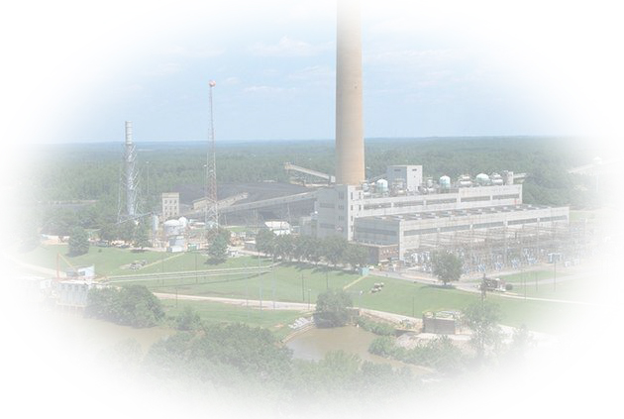
CCS Field Test & Demonstration Projects
Location & Cost Share
Awarded
In Negotiation
Archer Daniels Midland
Industrial Power & Ethanol
$206M – Total
$138M – DOE
Basin Electric
Post Combustion CO₂ Capture
$287M – Total
$100M – DOE
FutureGen 2.0
Ameren/FutureGen Alliance
Oxy-combustion
CO₂ Pipeline and Storage Facility
$990M – DOE
HECA
Commercial Demo of Advanced
IGCC w/ Full Carbon Capture
$2.840B – Total
$308M – DOE
NRG
Post Combustion CO₂ Capture
$334M – Total
$167M – DOE
AEP
Post Combustion CO₂ Capture
$668M – Total
$334M – DOE
Summit TX Clean Energy
Commercial Demo of Advanced
IGCC w/ Full Carbon Capture
$1.727B – Total
$450M – DOE
Southern Company
IGCC-Transport Gasifier
w/Carbon Capture
$2.880B – Total
$270M – DOE
Air Products
H₂ Production
$430M – Total
$284M – DOE
Leucadia Energy
Methanol
$436M – Total
$261M – DOE
Notes:
23

Slide 24
Future Benefits of Accelerated CCS R&D
A Prospective Look . . .
Savings for the Period 2020 thru 2050 | EPA Base Case CCS Task Force Waxman-Markey | STEP Base Case April 2010
Electricity cost savings | $105 Billion | $300 Billion
Capital expenditures savings | $20 Billion | $80 Billion
Benefits of Accelerated R&D
Deploying 2nd Generation Technology
Starting in 2020

Slide 25
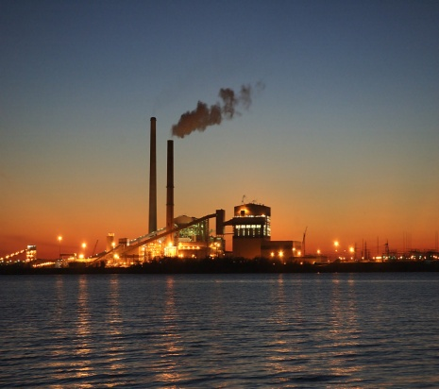
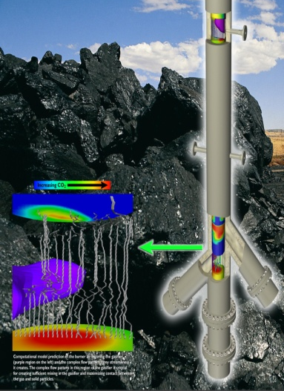
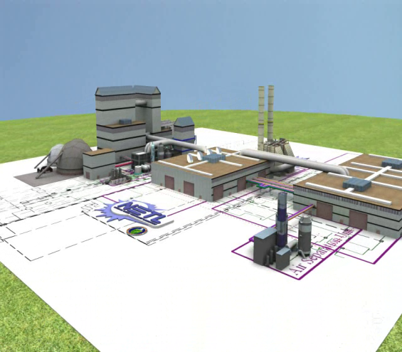


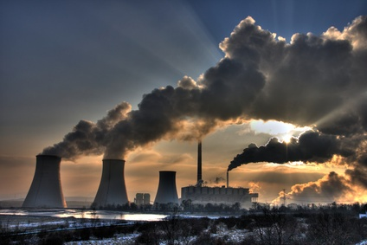


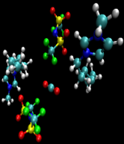




Carbon Capture Simulation Initiative
Science-Based Computational Tools for Accelerating Carbon Capture Technology Development & Deployment
Energy, structure
Charge, force field
Interaction mechanisms
Ab initio QM
Thermo dynamic Properties
Transport Properties
Monte Carlo
Molecular Dynamics
Search for better ILs
Modify IL functionality
Discover new IL
A new ionic liquid that exhibits high CO₂ permeability and CO₂/H₂ selectivity was identified with this method.
Identify promising concepts
Develop optimal designs
Quantify technical risk in scale up
Accelerate learning during development & deployment
Notes:
The goal of carbon capture simulation initiative is to develop a science-based simulation tools that can be used for accelerating carbon capture technology development. The simulations will address CO2 separation from the flue gas of a pulverized coal plant or the fuel gas of a coal gasification plant. Typically it takes 20-30 years for energy technologies to move from the lab to wide-spread deployment; we want the simulations tools to help reduce that time so that the DOE goal of rapid deployment of carbon capture and storage technology to 100’s of plants can be met. We will develop a simulation framework to integrate models that span from material-scale to device-scale to plant-scale. That will result in complete and consistent models of power plants integrated with carbon capture technology. The development will be industrial case-study driven, involving industrial partners from the beginning of the project. The simulations will support the traditional use of models for identifying promising concepts and for developing optimal device and plant scale designs. Furthermore, we intend to include uncertainty quantification and risk analysis and quantify the technical risk during scale up. Ultimately the science-based models will help accelerate learning during the development and deployment of models.
A broad spectrum of simulation capabilities are required to achieve the objectives of the initiative. We have assembled a team of simulation experts from five national labs. Their capabilities span computational chemistry, computational fluid dynamics, process simulation, dynamic and real-time simulation, optimization, uncertainty quantification, risk analysis, and industrial applications of simulation tools.

Slide 26
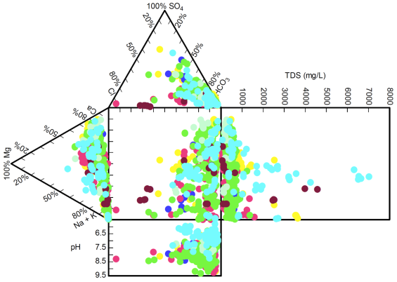
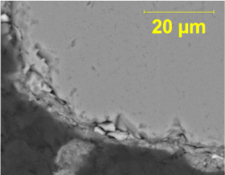
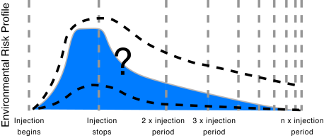
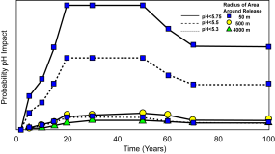
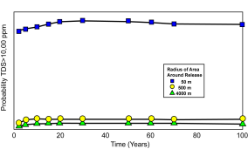
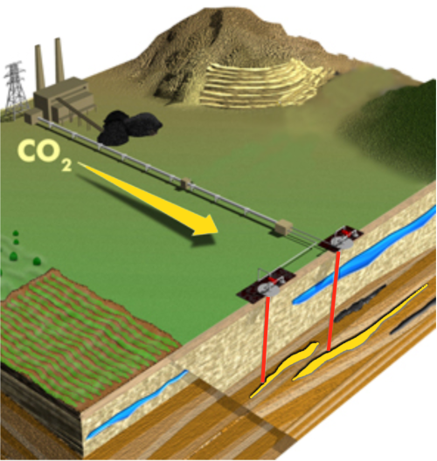
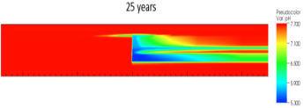
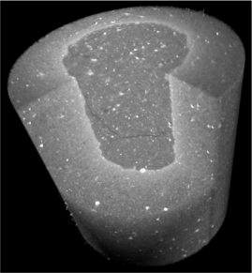
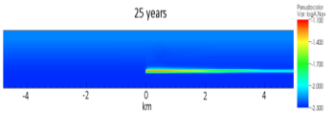
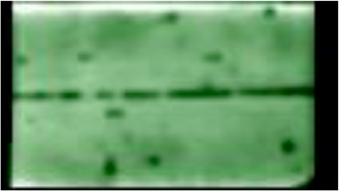

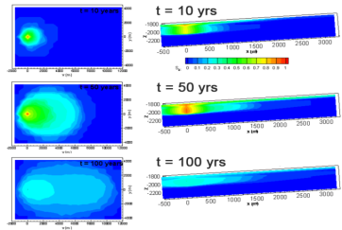
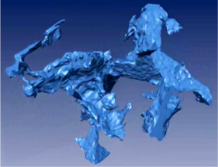
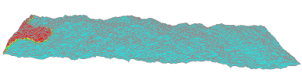






National Risk Assessment Partnership (NRAP):
Science-Based Assessment of Potential Liability for Long-Term CO₂ Storage
Goals
Develop methodology for quantifying risk and potential long-term liability
Ensure science base and defensibility
Integrate monitoring & mitigation to lower risk
Risk Profile Quantification
Science Base to Reduce Uncertainty
Based on preliminary model of 50-yr injection in target formation, leakage through wellbores, and impact within receptors.
Coupling of field, experiment, and theory to determine controls on aquifers geochemistry
schematic risk profile (after Benson, 2007)
pH
Risk
Proxies
TDS
Clay coating
Reactive-Flow Simulators
for Groundwater Geochemistry
from Keating et al., 2008)
Potential Receptors or Impacted Media
pH
Rates & mechanisms of alteration of permeability in wellbore cement and caprock fractures due to CO₂
bridging of flow path
log[a(Na+)]
Release and Transport
Simulators, Analytical Expressions
for Release and Transport
Integrated Assessment Model for Risk Assessment
Elucidation of key pore-scale phenomena (e.g., residual trapping, changes in permeability)
Reservoir Simulators
for Pressures, Saturations, …
Storage Reservoir
Simulations with real geometries at of pores and fractures (from CT) allow determination of flow dynamics and scaling relations (for permeability).
Notes:
The middle section is the core of NRAP: quantifying the risk profiles. It shows our preliminary model results, with the Integrated Assessment Model (akin to APECS) with a high fidelity reservoir model that couples to a wellbore release model (based on an abstraction from high fidelity simulations) that couples to a high fidelity groundwater model. The output is the risk profiles (a couple of which are shown at top.
The left section is the schematic of what NRAP is trying to accomplish (goals, approach, etc.). The Integrated Assessment Model is the term that the oil/gas/environmental community uses for the coupling of high fidelity models through a system model.
The right side shows some of the fundamental science gaps that NRAP is filling in for the risk profiles, with examples for each of the system components:
* pore scale characterization (with CT) to enable pore-scale calculations to predict permeability changes, residual trapping, etc.
* experimental determination of permeability changes to wells and caprocks due to geochemical interactions with CO2 and brine
* field/lab/theory to improve prediction of changes to aquifer geochemistry

Slide 27
NETL - A History of Innovative Solutions
1970s 1980s 1990s 2000s
Clean Air Act
Oil Embargo
Acid Rain
Utility Deregulation
Climate Change
National response to address air quality concerns
Profound impact on existing (and future) coal burning power plants
Exposed the Nation’s vulnerability to oil supply disruptions
U. S. imposes price controls on domestic oil – search for alternatives
National trans-boundary response to natural resource preservation
Identifies SO2 and NOX from fossil energy use as principal culprits
Changed utility business model
Competitive pricing drives investment efficiency - private sector investment in R&D reduced
A global issue
President targets 80%
reduction in CO2 by
2050
Congress considers
cap-and-trade
New power system technology (CFBC)
Emission control technologies for existing plants target NOX, SO2, and Particulates
  Installed on 75% of U.S. coal plants; 1/2 to 1/10 cost of older systems
… fossil’s programs made a significant contribution to the well-being of the United States, lead to realized economic benefits, energy options for the future, and significant knowledge …
National Academy of Sciences 2001: “Energy Research at DOE (1978-2000) - Was it Worth it?
Coal processing technology advances - but markets fail to develop
  Successful demonstrations (coal liquids, SNG, chemicals)
  First gasification-based pioneer plants – Dakota Gasification
… technology advancements were achieved that can provide energy security benefits and are available to be deployed if market conditions materialize … the ability to use the nation’s large coal reserves in an efficient manner was improved substantially …
National Academy of Sciences 2001: “Energy Research at DOE (1978-2000) - Was it Worth it?
Integrated CCS energy systems (highly efficient, zero emission, affordable)
  CCS (pre & post-combustion capture, site characterization, MVA, Best Practices)
  Fuel processing & separation (gasifiers, O2/H2 membranes, feed-pump, gas cleaning
  Power generation (H2 turbines, SECA-SOFC, oxy-combustion, chemical looping)
…the Regional Partnerships is an excellent program that will achieve significant results for CCS in the United States, Canada and internationally … the Partnerships Programme will significantly advance and accelerate the CCS field. The individual projects will together build a comprehensive and expansive research programme, the size and scope of which is unique throughout the world …
IEA 2008: “Expert Review of Regional Carbon Sequestration Partnerships Phase III”.

Slide 28
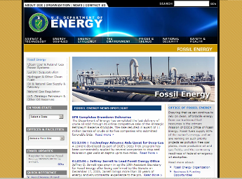
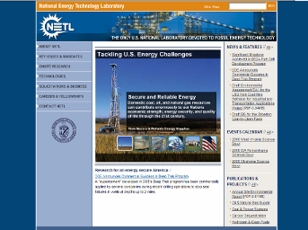
For Additional Information
Anthony Cugini
412-386-6023 –or– 304-285-4684
anthony.cugini@netl.doe.gov
Office of Fossil Energy
www.fe.doe.gov
NETL
www.netl.doe.gov
Notes:
28

